Slide 1

Customer Data Analysis
Capstone Project Report
Team Code:
PTID-CDA-SEP-25-741
Batch:
12-MAY-25-CDA-BUN-040-WDM1130-BAN
Team Members:
Pruthiraj Samal (pruthirajsamal8802@gmail.com)
Debabrata Das (debabratad330@gmail.com)
Institute: DataMites

Slide 2
Project Introduction
Project Objective
Dataset Timeline
Tools & Technology
Comprehensive analysis of customer shopping behavior and patterns to drive business insights and strategic decision-making.
Analysis covers customer data spanning from 2021 to 2023, providing three years of shopping trends and behaviors.
Power BI for visualization, SQL for data querying, and Excel for data processing and analysis.

Slide 3
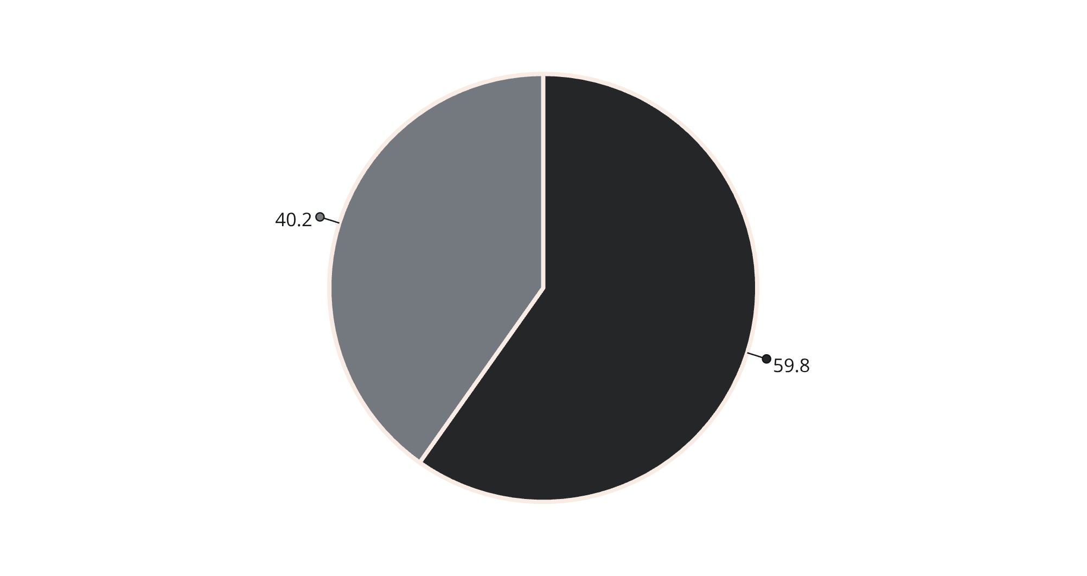

Shopping Distribution by Gender
🔑 Key Insight
Women dominate shopping share with nearly 60% of all shopping activities, indicating a significant gender preference in consumer behavior.
This substantial gender gap suggests targeted marketing strategies should prioritize female demographics for maximum impact and ROI.
Female
Male

Slide 4

Products Sold by Gender
179K
120K
Female Purchases
Male Purchases
Total products purchased by female customers
Total products purchased by male customers
🔑 Key Insight
Women purchase significantly more products overall, with 179K units compared to 120K for men. This 49% higher purchase volume reinforces the importance of female-focused product strategies and inventory planning.

Slide 5
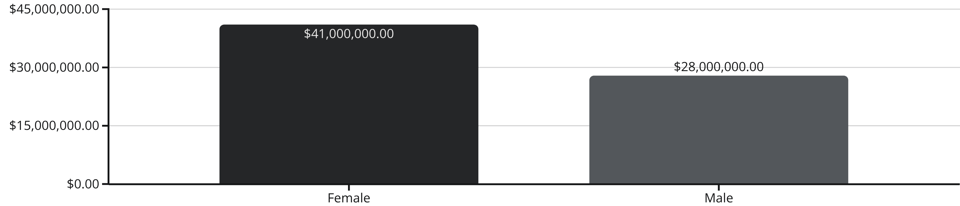
Revenue Contribution by Gender
🔑 Key Insight
Female customers generate significantly higher revenue at $41M compared to $28M from male customers. This 46% revenue advantage demonstrates the critical importance of maintaining strong female customer relationships and satisfaction.

Slide 6



Shopping Distribution by Age Group
26.7%
15.4%
Ages 56+
Ages 18-25
Highest shopping group
Lowest shopping group
The age distribution reveals surprising patterns in shopping behavior across different generations. Senior customers (56+) represent the largest shopping segment, while young adults show the lowest participation rates.
🔑 Key Insight
Seniors are the largest shopping group at 26.7%, while young adults (18-25) represent only 15.4%. This suggests opportunities to engage younger demographics through targeted digital marketing and trendy product offerings.

Slide 7
Products Sold by Age Group
80K
Products purchased by customers aged 56+
Senior Dominance
Strategic Implications
The 56+ age group leads in product purchases with 80,000 units, demonstrating strong purchasing power and shopping frequency among older demographics.
This trend indicates the need for age-appropriate product selections, accessible shopping experiences, and senior-friendly customer service approaches.
🔑 Key Insight
Seniors buy the most products, reinforcing their position as a crucial customer segment that drives significant volume and should be prioritized in business strategies.

Slide 8
Revenue by Age Group
$18.2M
🔑 Key Insight
Seniors are the most profitable age group, contributing $18.2M in revenue. This reinforces the importance of senior-focused marketing and customer retention strategies.
Ages 56+
Highest revenue generation
Senior customers not only purchase the most products but also generate the highest revenue, making them the most valuable customer segment across multiple metrics.

Slide 9
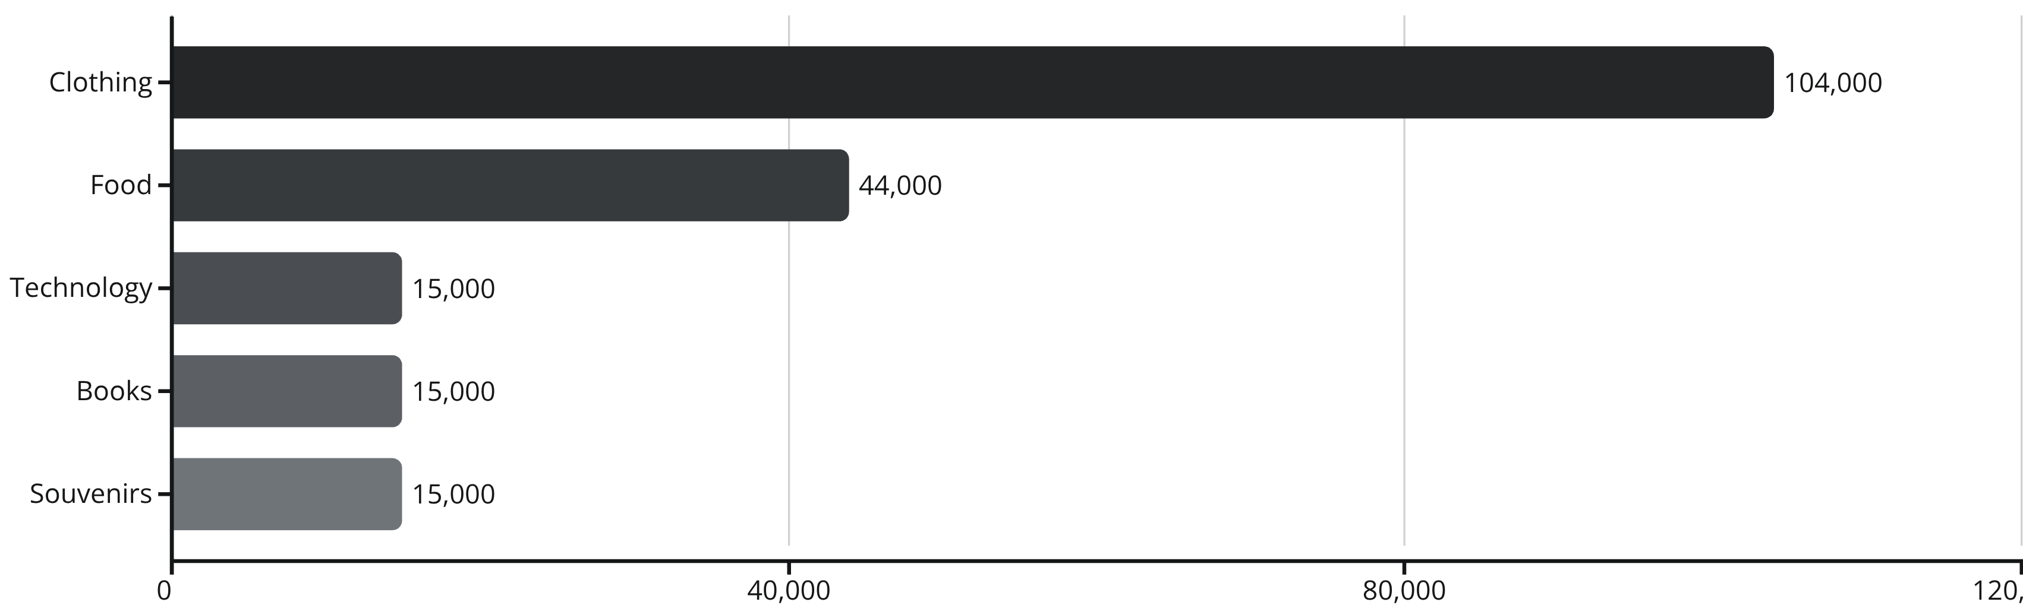
Product Category Performance
🔑 Key Insight
Clothing dominates with 104K units sold, followed by Food at 44K. Technology, Books, and Souvenirs each show 15K units, indicating significant opportunities for growth in these underperforming categories.

Slide 10

Key Insights & Strategic Recommendations
Key Insights
Business Recommendations
Demographics Drive Revenue
Target Priority Segments
Women and seniors are the primary revenue drivers, accounting for the majority of purchases and spending.
Focus marketing efforts on women and senior customers who drive the highest revenue and purchase volumes.
Category Concentration
Clothing and Food dominate sales, while other categories show significant growth potential.
Category Development
Boost underperforming categories (Technology, Books, Souvenirs) with targeted promotions and strategic offers.
Payment Preferences
Cash remains the most preferred payment method, though digital adoption is growing steadily.
Digital Payment Incentives
Promote digital payment adoption through cashback programs and exclusive digital-only offers.

Slide 11

Thank You
We appreciate your time and engagement. We trust these insights will empower informed decisions and future success.

